Slide 1



UNIT 7; Choices
Lesson 1;
Body and mind

Slide 2
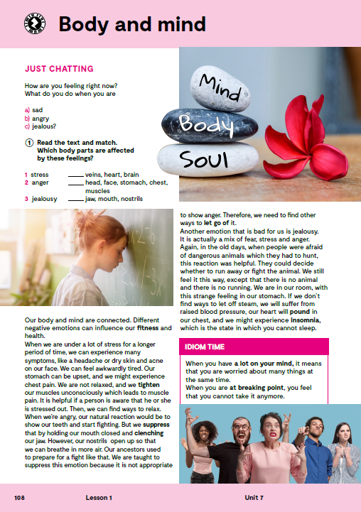
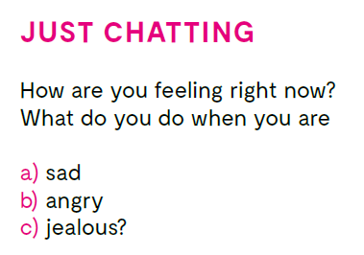
What do you do when you are sad?
What do you do when you are angry?
What do you do when you are jealous?

Slide 3
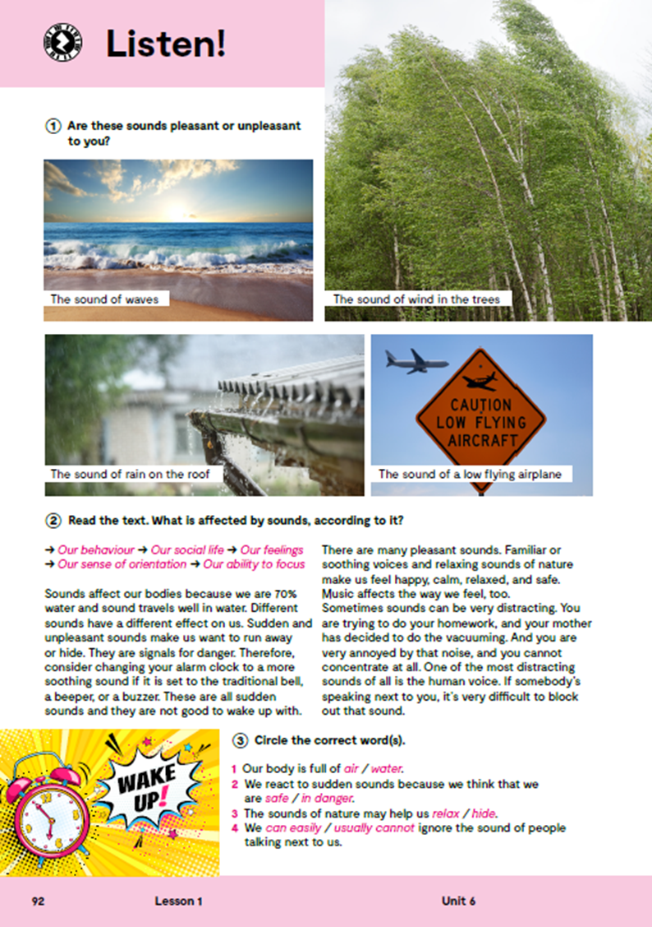
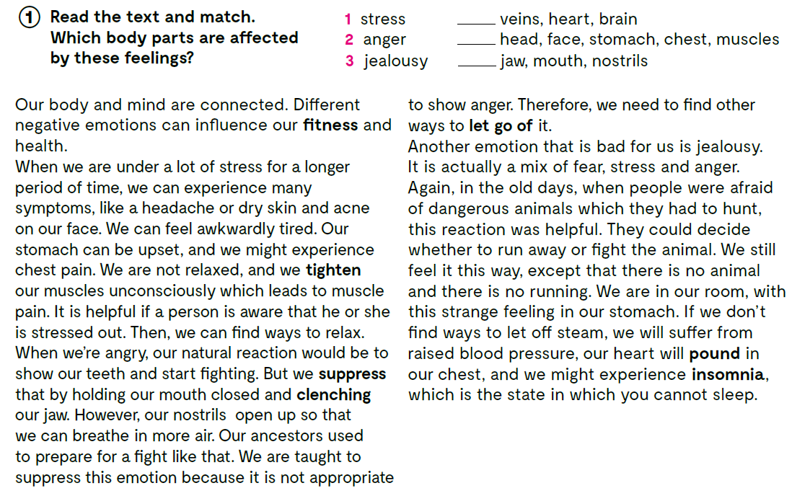
3
1
2

Slide 4

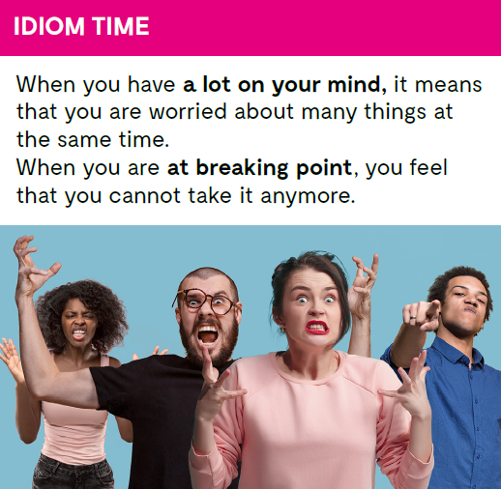

Slide 5
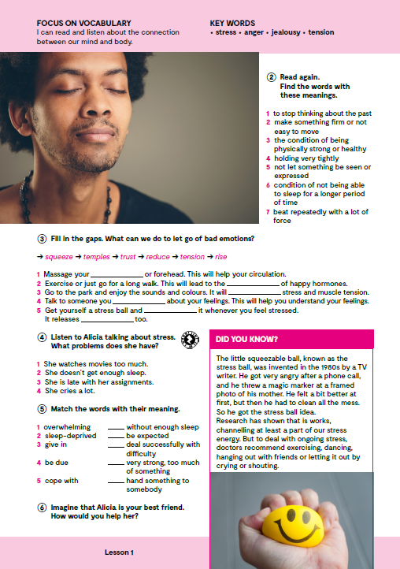
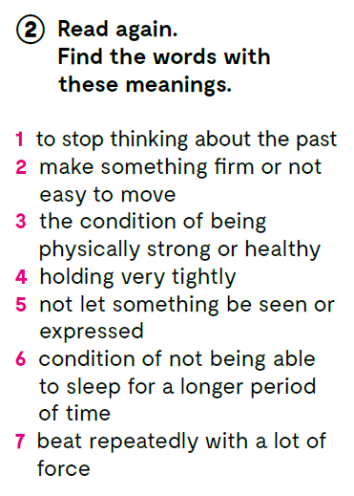
1 let go of
2 tighten
3 fitness
4 clenching
5 suppress
6 insomnia
7 pound

Slide 6
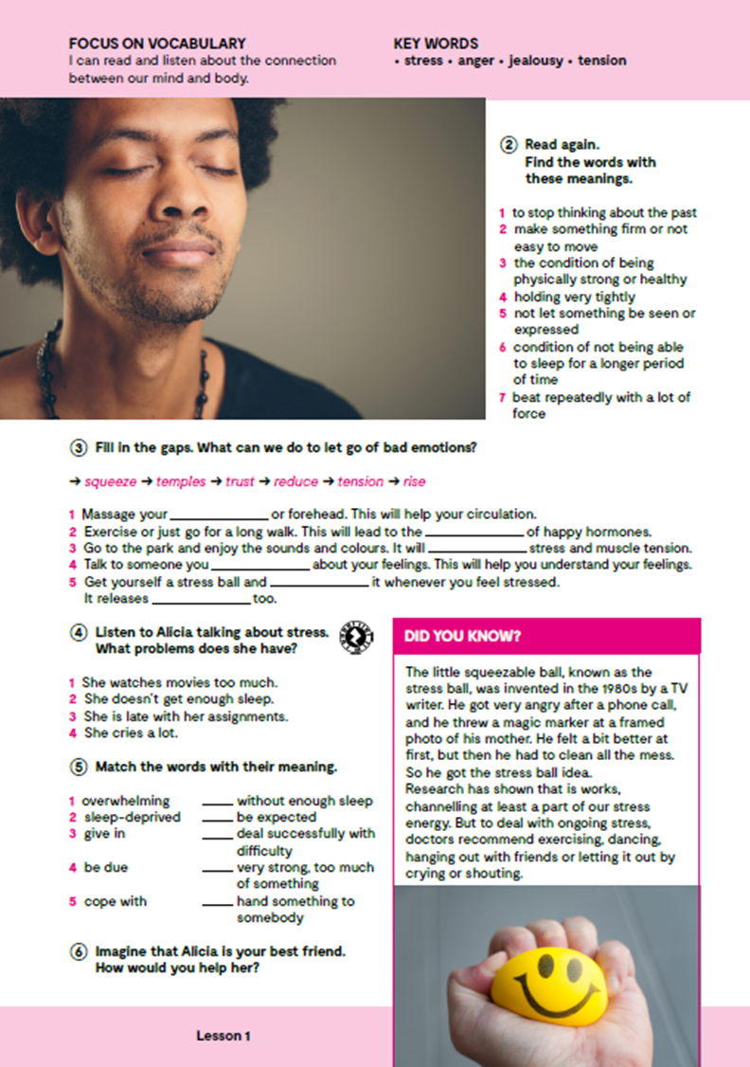
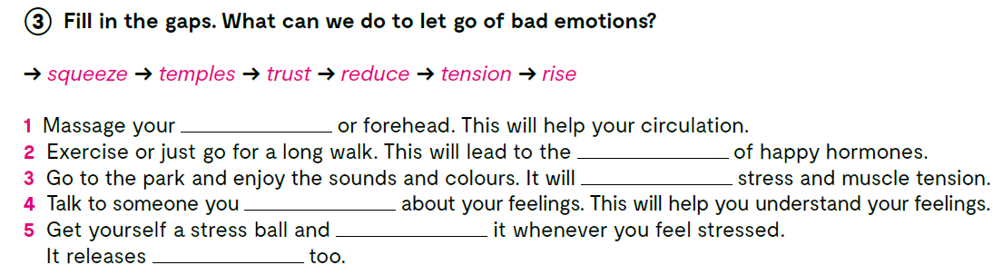

temples
rise
reduce
trust
squeeze
tension
Open the following link and then click on LEARN MORE!
https://www.e-sfera.hr/dodatni-digitalni-sadrzaji/5473b98d-2efe-4e37-bb99-f81871abf58f/
The good, the bad, and the worst - A story of stress
Read the texts and do the tasks.

Slide 7
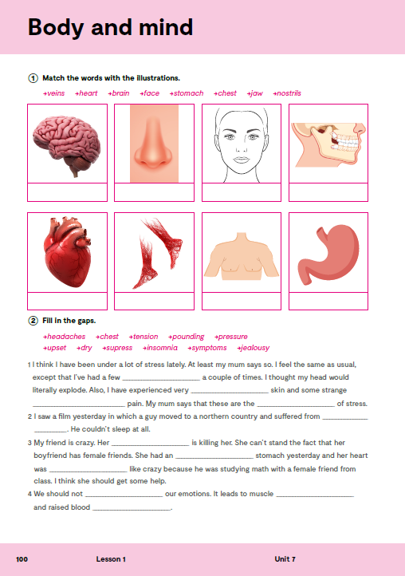
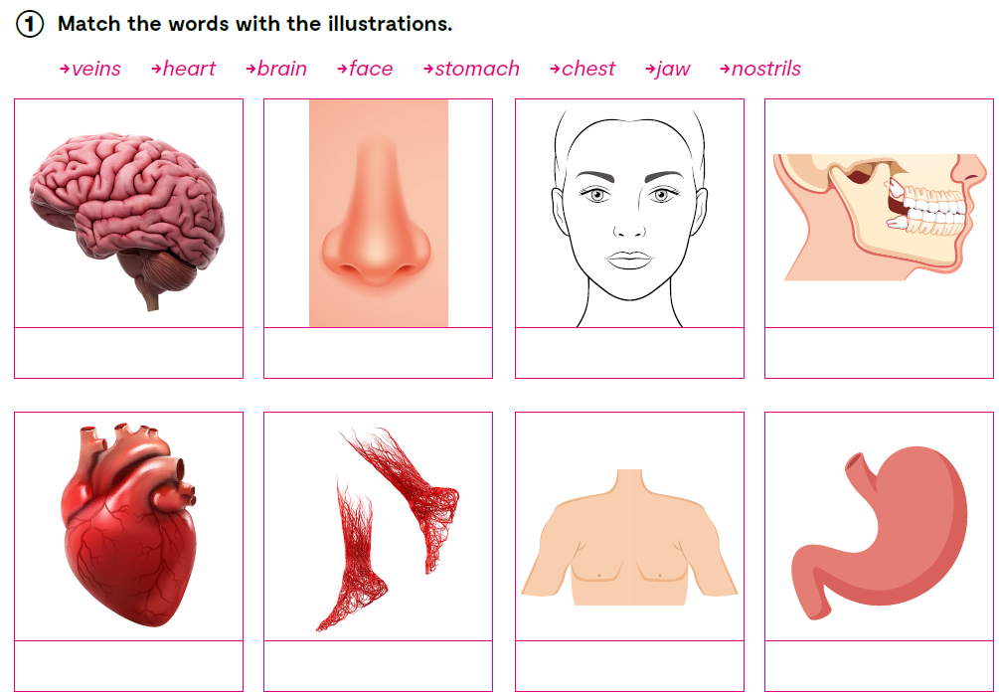
brain
nostrils
face
jaw
heart
veins
chest
stomach

Slide 8

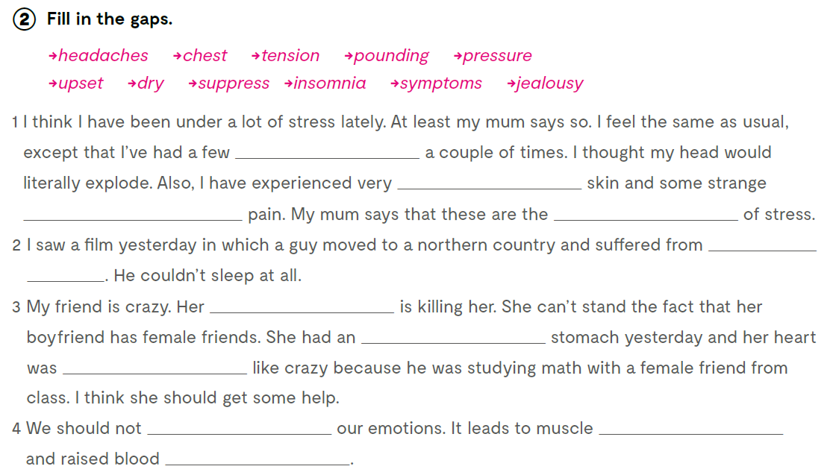
headaches
dry
chest
symptoms
insomnia
jealousy
upset
pounding
suppress
tension
pressure

Slide 9

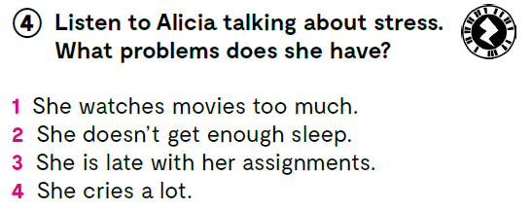


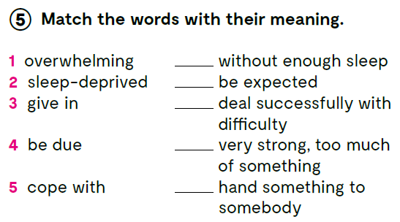

Listen to Alicia talking about stress. What problems does she have?
https://www.e-sfera.hr/dodatni-digitalni-sadrzaji/5473b98d-2efe-4e37-bb99-f81871abf58f/assets/audio/27_unit_7__lesson_1__exercise_4.mp3
2
4
5
1
3

Slide 10

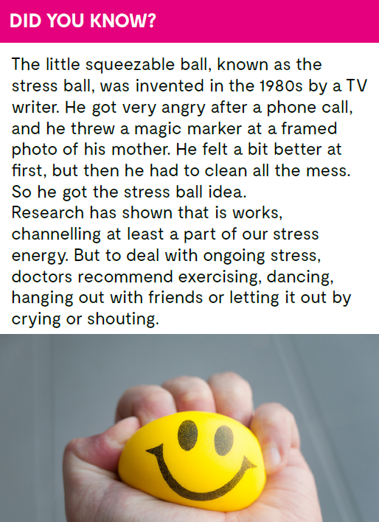
Check what you have learnt.
https://www.bookwidgets.com/play/6CA396P
https://wordwall.net/play/13430/307/360

Slide 11
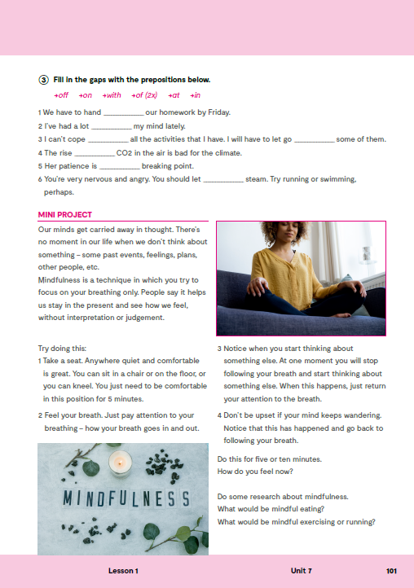
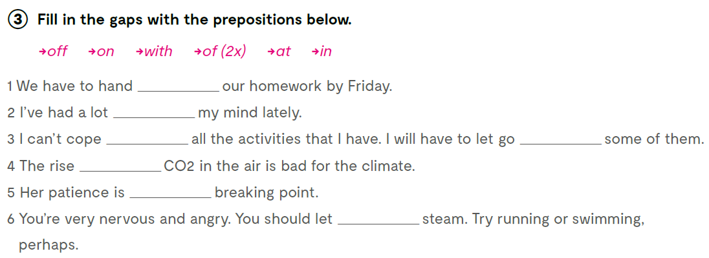
workbook, page 101.
in
on
with
of
of
at
off
Answer the following questions.
https://surveyhero.com/c/pvc3ykdq

Slide 12

